Slide 1

Fundamentals of Deep Learning: Perceptrons, Artificial Neural Networks, and Activation Functions

Slide 2

What is Deep Learning?
Deep Learning is a part (subset) of Machine Learning that uses neural networks with many layers — that’s why we call it “deep”.
Think of it like teaching a computer to learn patterns from data just like our brain does — using artificial “neurons.”
Each neuron receives some information, processes it, and passes it to the next layer.
Notes:
It’s a way to teach computers by stacking many “layers” of math functions (a neural network) so the system can learn patterns directly from data.
“Deep” just means “many layers.” More layers let the model learn simple things first (like edges in images) and then combine them into complex ideas (like faces or road signs).
---
We will cover an overview of deep learning, explore the perceptron as the building block of neural networks, understand the architecture and mechanisms of artificial neural networks, and discuss the role and types of activation functions used in these networks.
Image source: Microsoft 365 content library

Slide 3
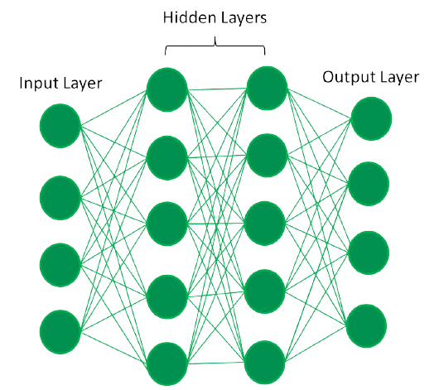
How Deep Learning Works?
Neural network consists of layers of interconnected nodes or neurons that collaborate to process input data. In a fully connected deep neural network data flows through multiple layers where each neuron performs nonlinear transformations, allowing the model to learn intricate representations of the data.
In a deep neural network, the input layer receives data which passes through hidden layers that transform the data using nonlinear functions. The final output layer generates the model’s prediction.

Slide 4
Core concepts of deep learning
Neural networks (NN)
Deep neural networks (DNN)
Activation functions
Forward pass, loss, backpropagation

Slide 5
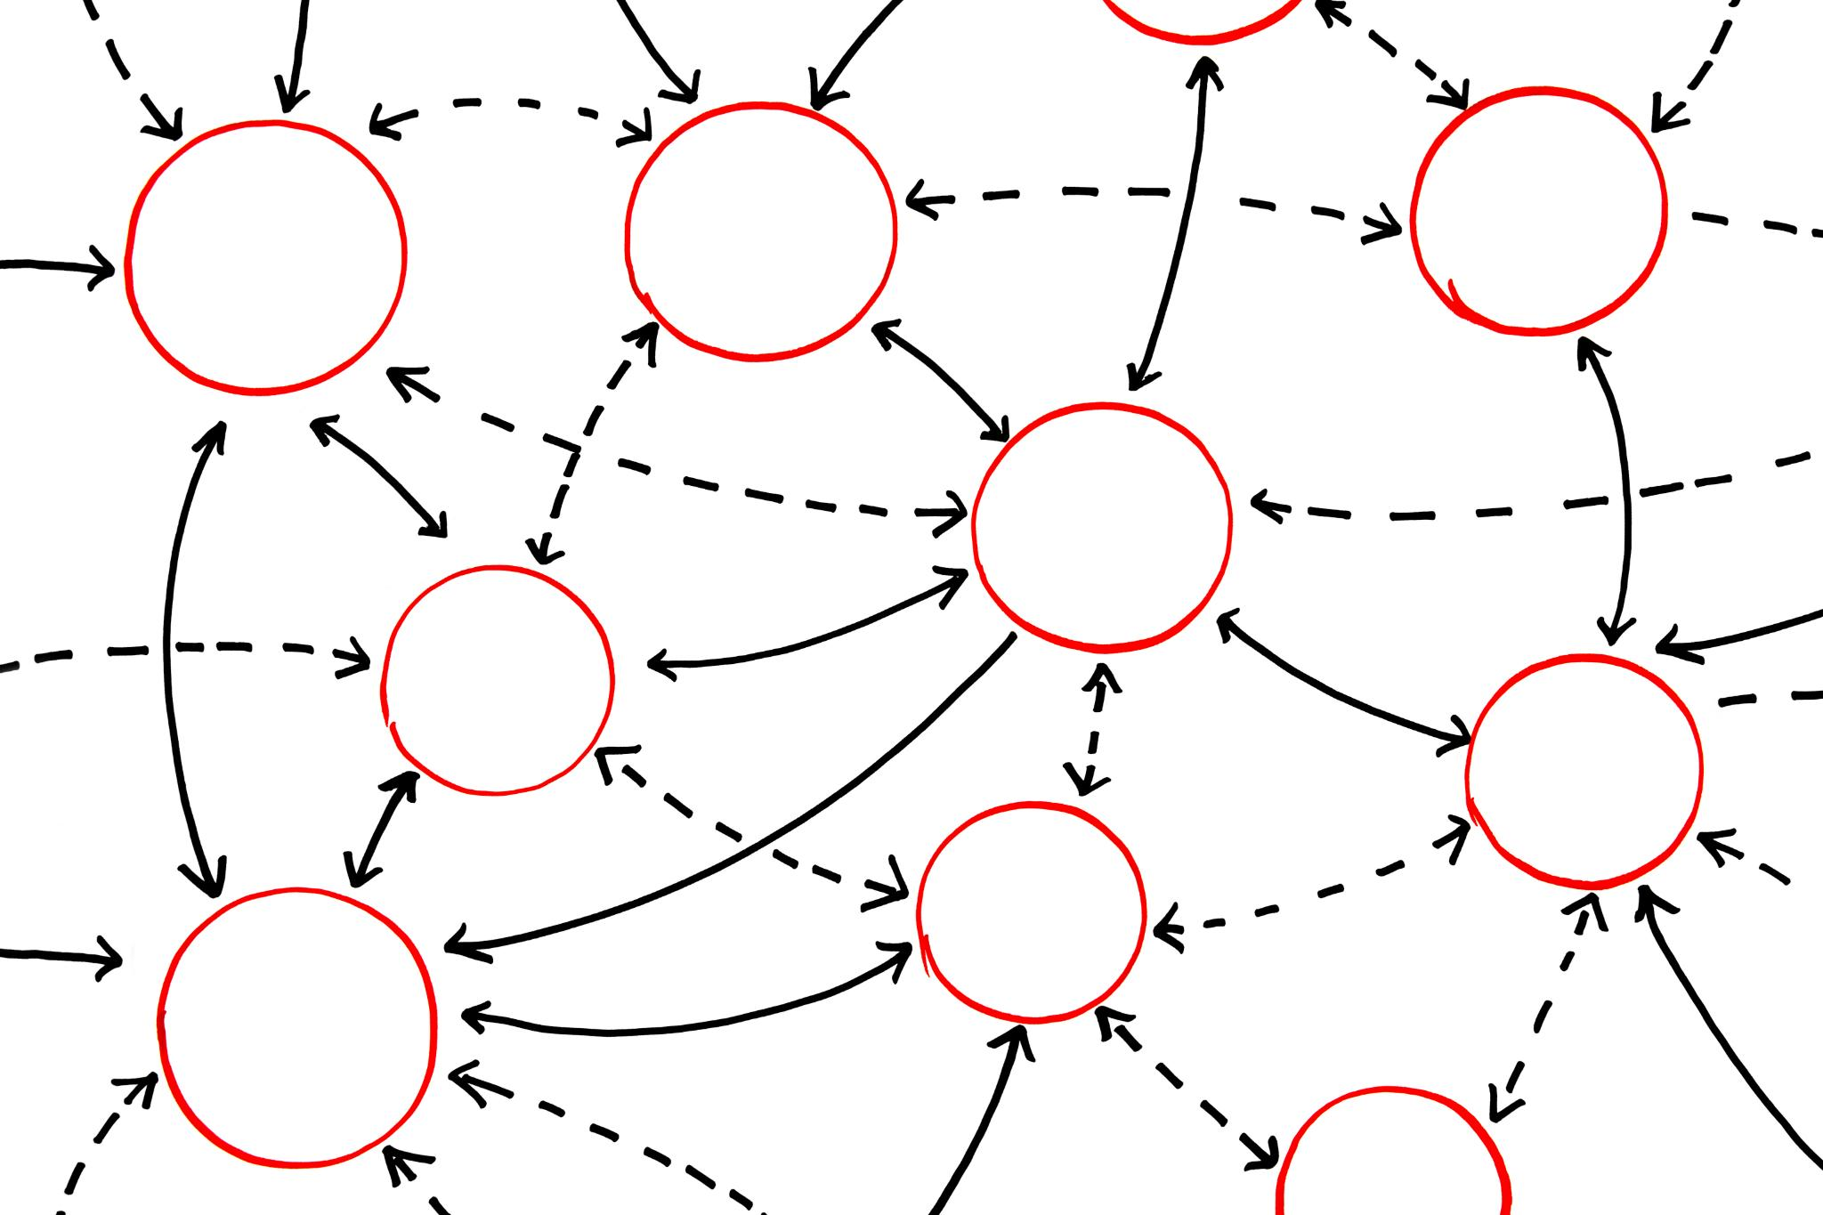
Neural networks (NN)
Idea: a stack of simple math units (“neurons”) that transform inputs step by step to produce an output.
Each neuron does a weighted sum plus bias, then a non-linear activation:
z=w⋅x+b, a=σ(z)
Layers: input → hidden layers → output.
Learning means adjusting weights/biases so outputs match targets.
Why layers? Early layers learn simple patterns; deeper layers combine them into richer concepts.
Notes:
---
A perceptron consists of input nodes, weights, a summation function, and an activation function. It computes a weighted sum of inputs and applies a threshold to produce a binary output.
Image source: Microsoft 365 content library

Slide 6

Deep neural networks (DNN)
“Deep” = multiple hidden layers (more than one). Depth lets the model represent very complex functions.
Trade-offs: more capacity and accuracy potential, but needs more data, more compute, and stronger regularization to avoid overfitting.
Notes:
---
A perceptron consists of input nodes, weights, a summation function, and an activation function. It computes a weighted sum of inputs and applies a threshold to produce a binary output.
Image source: Microsoft 365 content library

Slide 7
Activation functions
Purpose: introduce non-linearity so the network can model complex relationships (lines alone can’t fit curves)
Common activation functions:
  ReLU
  Sigmoid
  Tanh
Notes:
---
A perceptron consists of input nodes, weights, a summation function, and an activation function. It computes a weighted sum of inputs and applies a threshold to produce a binary output.
Image source: Microsoft 365 content library

Slide 8

Forward pass, loss, backpropagation
Forward pass: data flows layer by layer to produce predictions.
Loss function: measures prediction error (e.g., cross-entropy for classification, MSE for regression).
Backpropagation: compute gradients of the loss w.r.t. every weight via chain rule; tells each weight how to change.
Optimizer (e.g., SGD, Adam): updates weights using gradients. Repeat many steps over data until loss is small.
Notes:
---
A perceptron consists of input nodes, weights, a summation function, and an activation function. It computes a weighted sum of inputs and applies a threshold to produce a binary output.
Image source: Microsoft 365 content library

Slide 9
Perceptron
Single layered neural network

Slide 10
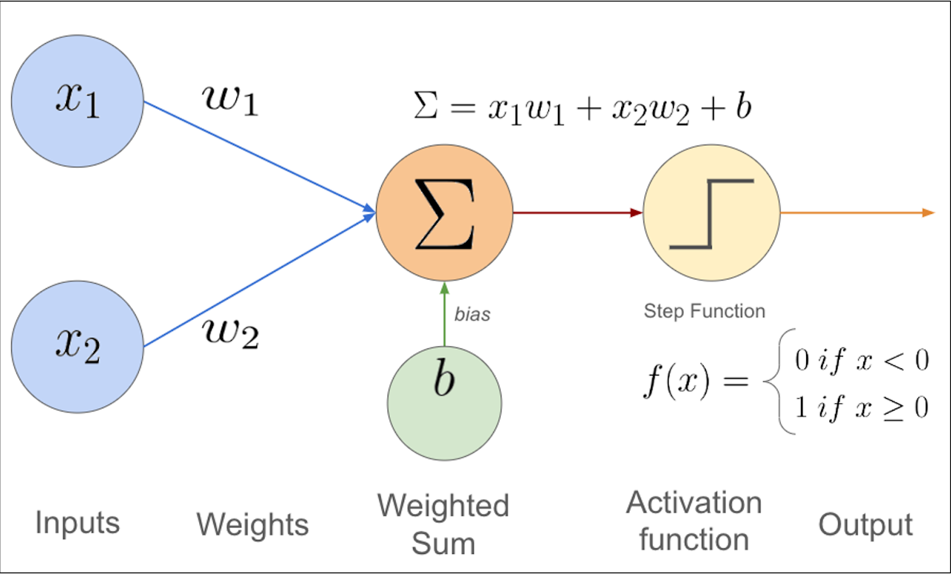
What is a perceptron?
A perceptron is a single “neuron” that does binary classification.
It takes inputs, multiplies them by weights, adds a bias, and passes the sum through a step-like activation to output 0 or 1.
Math form: f(x)=h(w⋅x+b), where h is a step function (outputs 1 if input > 0, else 0).

Slide 11
The perceptron learning rule (online update)
If the prediction is correct (e=0e=0), do nothing.
If wrong, update toward the true label:
  Weights: w←w+ηex
  Bias: eb←b+ηe
η is the learning rate (a small positive number).
Intuition: If we predicted 0 but the truth is 1 (e=1), we add a bit of x to w and increase b so z is larger next time; the boundary moves toward correctly classifying this example. If we predicted 1 but truth is 0 (e=−1), we subtract a bit of x and decrease b, shrinking z.

Slide 12
Advantages & disadvantages of perceptron
Advantages
Simple & fast: easy to implement, trains quickly with the perceptron update rule, & works well for small, linearly separable problems.
Disadvantages
Online friendly: updates incrementally per example, so it adapts to new data without full retraining.
Interpretable geometry: decision boundary is a straight line/hyperplane, making the model’s behavior easy to visualize
Only linear separability: cannot solve non‑linear patterns (e.g., XOR) without additional layers or feature engineering.
Limited expressiveness: a single hyperplane can’t capture complex boundaries; performance plateaus on many real-world tasks.
Convergence limits: if data aren’t linearly separable, the algorithm may not converge and can oscillate; needs max-epoch safeguards.
Low compute & memory: minimal parameters and no complex optimization make it suitable for resource‑constrained settings.

